Slide 1
Nordic prescription registers Denmark
Jesper Hallas
Clinical Pharmacology
University of Southern Denmark

Slide 2
Essential demographics
Size of population: 5,566,856 as of July 1st 2011
Detailed public statistics available at www.statistikbanken.dk

Slide 3
Relevant host institution(s)
Statistics Denmark www.dst.dk
University of Southern Denmark (OPED)
Aarhus University (PDNJ)

Slide 4
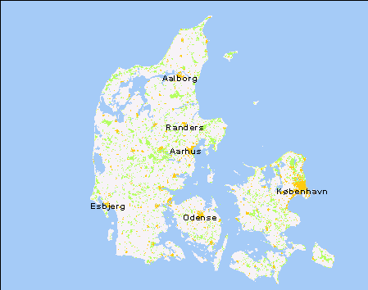
Pharmacoepidemiological databases in Denmark

Slide 5
Pharmacoepidemiologic databases in Denmark

Slide 6
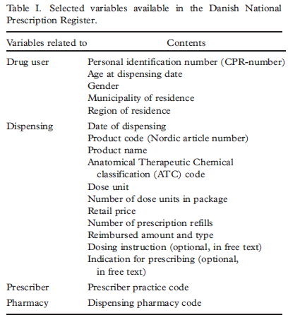
Prescription variables, what is covered?

Slide 7
Prescription variables, what is not covered?
Dosing instruction
Indication
…. except sometimes in free-text

Slide 8
Coverage of prescription database
National prescription database
All residents, independent of income
Re-imbursed and non-reimbursed prescriptions
Regional databases
All residents, independent of income
Only re-imbursed prescriptions (possibly by individual coverage)
Non-covered medication include:
drugs dispensed OTC
dieting products
oral contraceptives
Benzodiaxepines and cyclopyrrolones
Certain antibiotics (fluoquinolones, tetracyclines)

Slide 9
Danish Medicines Agency and Danmarks Statistik
A complete copy of the DKMA prescription register since 1995!
A complete copy of the Danish Patient Registry since 1977
Linkage enabled by mutual encrypted CPR-number
Access through secure connection. Only for authorised research institutions
Individual-level data are not given to researchers
Tables and analyses are transferred by e-mail to the researchers
”Forskerserviceenhed”
Contact: www.dst.dk/forskning

Slide 10
Linkage in regional databases
Regional prescription registers are allowed to transfer identifiable data to researchers.
Data on outcomes available for research from Danish National Health Board (www.sst.dk).
Both data transfers require approval from Data Protection Board (www.datatilsynet.dk)

Slide 11
Practicalitities
Whom to approach
www.dst.dk for national prescrption database
jhallas@health.sdu.dk for OPED
hts@dce.au.dk for PDNJ
www.sst.dk for outcomes data
Approvals
Ethics approval are not required for registry studies
Danish Data Protection Board (www.datatilsynet.dk) for all registry studies, also within Danmarks Statistik
Costs
In the order of 50.000 dkr for national data set.
Time
2-3 months for national data set

Slide 12
A few examples of papers
Kildemoes HW, Sørensen HT, Hallas J. The Danish National Prescription Registry. Scand J Public Health 2011; 39 (suppl 7): 38-41.
Davidsen JR, Søndergaard J, Hallas J, Siersted HC, Knudsen TB, Lykkegaard J, Andersen M. Impact of socioeconomic status on the use of inhaled corticosteroids in young adult asthmatics. Respir Med 2010 Dec 7.
Hallas J, Bjerrum L, Støvring H, Andersen M. Use of prescribed ephedrine and the risk of serious cardiovascular events. A registry based case-crossover study. Am J Epidemiol 2008, 168: 966-73
Gulmez SE, Holm A, Frederiksen H, Jensen TG, Pedersen C, Hallas J. Use of proton pump inhibitors and the risk of community-acquired pneumonia: a case control study. Arch Intern Med 2007; 167: 950-5.
Gaist D, Sørensen HT, Hallas J. The Danish prescription registers. Dan Med Bull 1997; 44: 445-8.
Furu K, Wettermark B, Andersen M, Martikainen JE, Almarsdottir AB, Sørensen HT. The Nordic countries as a cohort for pharmacoepidemiological research. Basic Clin Pharmacol Toxicol. 2010 Feb;106(2):86-94.
Johnsen SP, Larsson H, Tarone RE, McLaughlin JK, Nørgård B, Friis S, Sørensen HT. Risk of hospitalization for myocardial infarction among users of rofecoxib, celecoxib, and other NSAIDs: a population-based case-control study. Arch Intern Med. 2005 May 9;165(9):978-84.

