Slide 1
The Incidence of Benzodiazepine and Related Drug (BZDR) Use in Persons with and without Alzheimer’s Disease (AD)
Saarelainen L, Taipale H, Koponen M, Tanskanen A, Tolppanen AM, Tiihonen J, Hartikainen S . J Alzheimer’s Dis, Epub ahead of print Oct 17, 2015

Slide 2
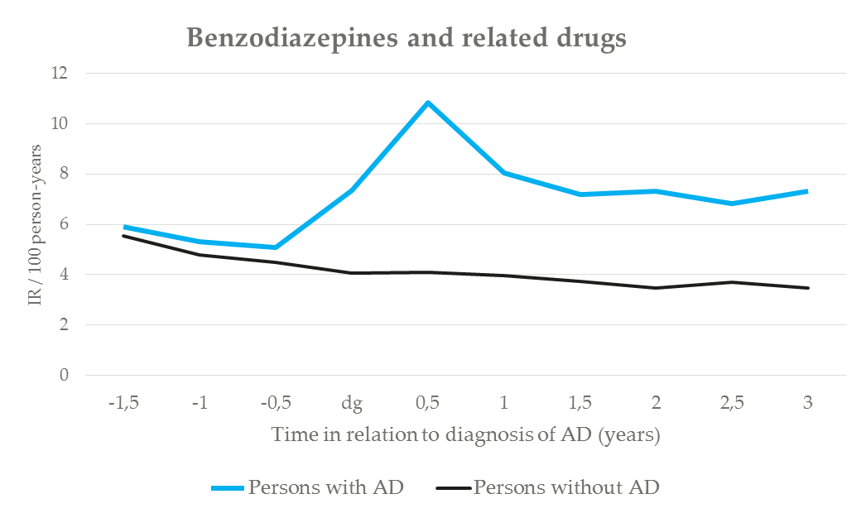
The Incidence of Benzodiazepine and Related Drug (BZDR) Use in Persons with and without Alzheimer’s Disease (AD)
BZDRs: wide use, details of use unknown
6-month incidence rates: comparison between persons with and without AD (incidence rate ratio)
This study: incidence of BZDR use, in relation to AD diagnosis
Incidence of BZDR use: 2 years before → 3 years after AD diagnosis (one-year washout)
Incidence rate ratio=2.6 (95% CI 2.5-2.8)
MEDALZ (Medication and Alzheimer’s disease) dataset based on Finnish nationwide registers
ATC classes for BZDRs: benzodiazepines N05BA and N05CD, Z-drugs N05CF
All persons diagnosed with AD during 2005-2011 (n=70,718) + comparison persons
Collected data: AD diagnosis, drug purchases, hospitalizations, death
Early treatment of behavioral and psychological symptoms of dementia? BZDRs’ may impair cognition → effect on AD treatment?
Saarelainen L, Taipale H, Koponen M, Tanskanen A, Tolppanen AM, Tiihonen J, Hartikainen S . J Alzheimer’s Dis, Epub ahead of print Oct 17, 2015

