Slide 1
REFILL ADHERENCE TO LIPID-LOWERING
MONOTHERAPHY IN SWEDISH PATIENTS
WITH TYPE 2-DIABETES
Sofia Axia Karlsson, PhD student
Section of Epidemiology and Social Medicine
Sahlgrenska Academy at the University of Gothenburg
sofia.karlsson@gu.se
Co-authors: Karolina Andersson Sundell, Björn Eliasson, Christel Hero,
Ann-Marie Svensson, Mervete Miftaraj, Soffia Gudbjörnsdottir, Katarina Eeg-Olofsson

Slide 2
Diabetes and Cardiovascular Disease (CVD)
Diabetes alone increases the risk of CVD
Dyslipidemia, a major risk factor for CVD in patient with type 2-diabetes
Purpose of the study
To describe and compare refill adherence to monotherapy of lipid-lowering drugs in patients with type 2-diabetes by previous CVD

Slide 3
Methods
Inclusion
18 years and older
Type 2-diabetes
New users
Linkage by personal identity number
National Diabetes Register
Swedish Prescribed Drug Register
National Patient Register
Cause of Death Register
Inclusion period
1 January 2007 – 31 December 2010
Exclusion
Extemporanous preparations
Acid bile sequestrants
Combination therapy
Observation period
Multi-dose dispensed drug
Date of death
Max. 3 years

Slide 4
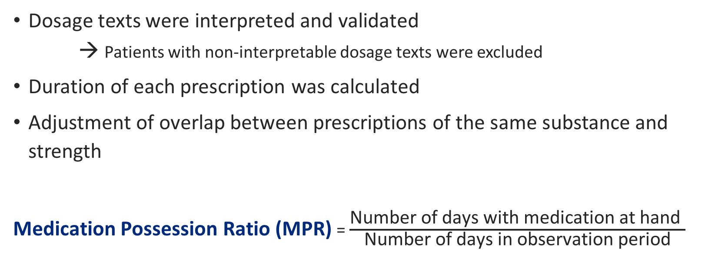
Methods
Dosage texts were interpreted and validated
  → Patients with non-interpretable dosage texts were excluded
Duration of each prescription was calculated
Adjustment of overlap between prescriptions of the same substance and strength
Medication Possession Ratio (MPR) = $\frac{\text{Number} \text{of} \text{days} \text{with} \text{medication} \text{at} \text{hand} }{\text{N}\text{umber} \text{of} \text{days} \text{in} \text{observation} \text{period}}$

Slide 5
Results
MPR
Number of patients
Men (%)
Mean age [SD] (years)
Median age (years)
Mean MPR [SD] (%)
Median MPR (%)
Total population
97,595
57.8
63.8 [11.3]
64
70.9 [31.1]
84.7
No previous CVD
65,894
54.7
61.2 [10.9]
62.0
69.0 [31.5]
81.9
Previous CVD
31,701
64.1
69.0 [10.4]
70.0
74.7 [29.7]
89.8
When adjusted for age and gender
Patients with previous CVD had 3.9% higher mean MPR

Slide 6
Thank you for listening!

