Slide 1
A comparison of statistical methods for combining observational data from multiple datasets
Nils Ekström, Marloes T. Bazelier, Vidar Hjellvik, Frank de Vries, Jari Haukka, Peter Vestergaard, Marie L. de Bruin, Zoltan Thinsz, Morten Andersen
Notes:
In this study we wanted to compare different statistical methods for combining observational data from multiple datasets.

Slide 2
Aggregate data Or Individual patient data
CDM
DATABASES
COMMON
PROGRAMS
Notes:
More specifically we wanted to compare the use of aggregate data with the use of individual patient data. This pictures illustrate meta-analysis based on aggregate data. We transformed data from DK, NO and SE to a common data model and used common programs to create analysis datasets. Regression models were run on data from each country and the country specific estimates were then pooled.
In the individual patient data meta-analysis, the country-specific datasets were combined in a common dataset and one regression analysis were run on the combined data.

Slide 3
Which method should we use?
Favors
Individual patient data
Favors
Aggregate data
Low power in individual studies
Uniform distribution of relevant available covariates
High power in all studies
Uneven distribution of relevant available covariates
Notes:
So which method should we use? Well, we found that a situation with low power in the individual studies and a uniform distribution of relevant covariates favours the use of individual patient data, wheras the opposite situation favours the use of aggregate data.

Slide 4
Distribution of potential confounders between cohorts
Potential confounders
Age
Calendar year
Income
Alcohol abuse
NIADs
Contraceptives
HRT
Family history of cancer
Number of child births
Notes:
To compare these methods we looked at the association between different types of insulin and breast cancer.
Data on most of the potential confounders were available in all three countries. But, there were some additional data available in NO which could not be included in the individual patient data analysis but could be included in the aggregate data analysis.

Slide 5
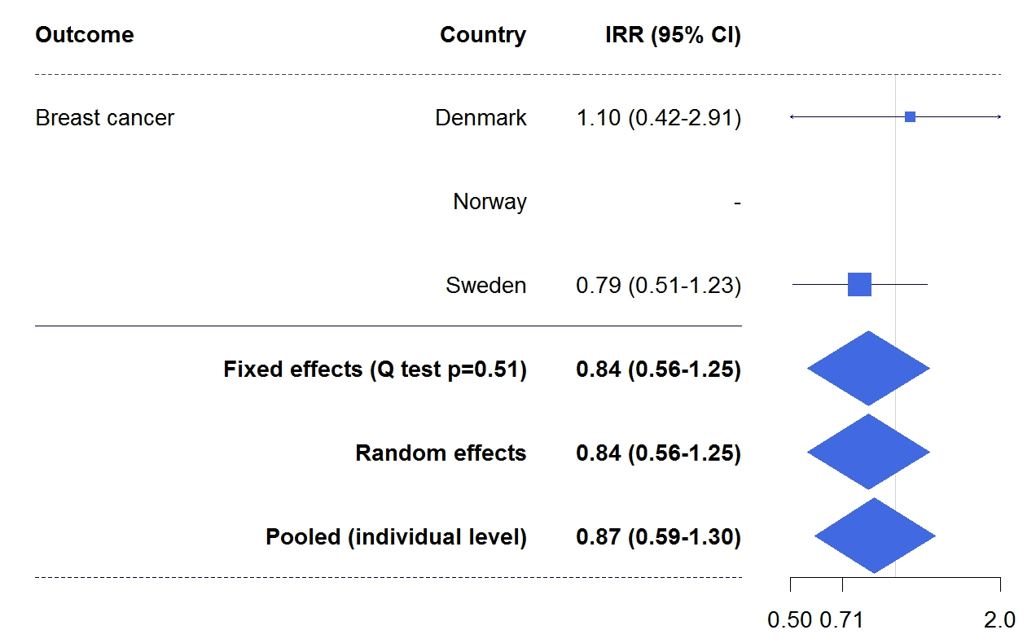
IRR for breast cancer with Glargine versus human insulin
Aggregate data
Individual patient data
Notes:
If we look at the comparison of Glargine vs human insulin, we can see that there was no significant difference in risk in the DK or SE cohorts. In the NO cohort, there were to few cases to produce an estimate. Therefor, the aggregate data metaanalysis only included data from the DK and SE cohorts while the individual patient data meta-analysis included data from all countries. However, despite these differences the results were similar.

Slide 6
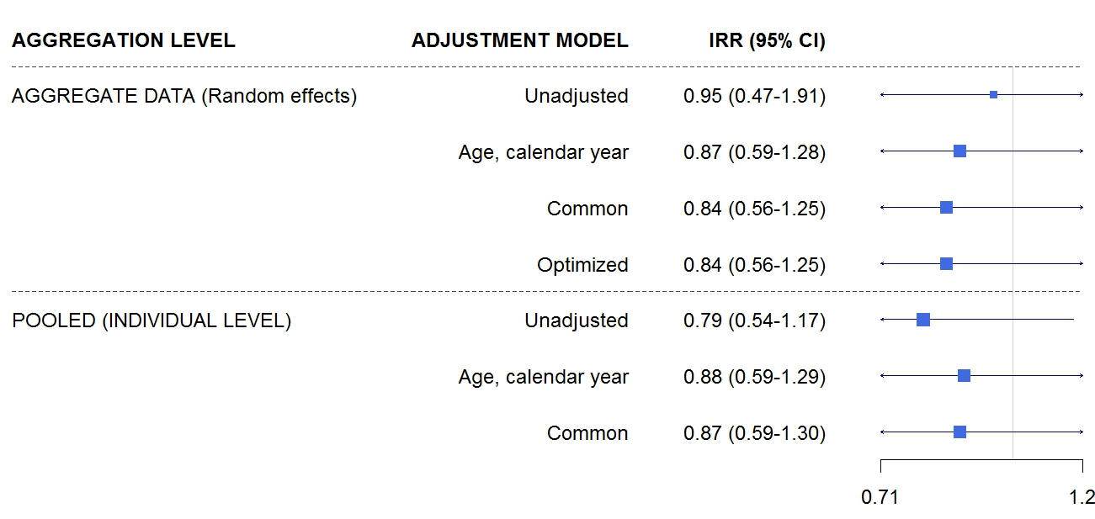
The impact of adjustment for potential confounders
Notes:
When we explored different adjustment models, we found that there was a clear change in estimate when adding age and calendar year to the unadjusted model. But adding additional covariates did not result in an important changes in the estimates.

Slide 7
Individual patient data meta-analysis versus meta-analysis on aggregate data
Power of individual studies (+)
Favors aggregate data
meta-analysis
(-)
Common covariates (+)
Favors individual patient data meta-analysis
(-)
Notes:
So if we create a diagram with the power of the individual studies on the y-axis and the availability of common relevant covariates on the x-axis. Our study is somewhere down here. Which we could show is a situation that’s more suitable for individual patient data meta-analysos, But in other situations, with high power in the individual studies and an uneven distribution of relevant covariates between the studies, An aggregate data meta-analysis may be more favourable.

